Slide 1

Techniques de débogages
025948 - Diagnostiques de compilation, techniques de débogage
Steve Fotso
025914 - Assurance de qualité logicielle

Slide 2
Introduction
Peu importe le niveau d’expérience en programmation, les erreurs seront toujours présentes durant la programmation.
Avec la pratique, on devient meilleur à ne pas faire trop d’erreurs durant le processus de programmation, et bien meilleur à trouver des erreurs dans le code et les corriger.
Notes:
The consequences of these can prove to be extremely frustrating and expensive:
The general perception of the quality of the output begins to deteriorate as the team spends more and more time in fixing bugs than in actually creating new features
In extreme cases, adding features becomes virtually impossible with seemingly unrelated parts of the system failing due to the addition of a feature or, worse – fixing an earlier bug
Costs of adding features increases at an alarming rate with each delivery cycle
Adding more people becomes difficult, as they take a long time to come up to speed; sometimes, new team members are blatantly scared to touch large parts of the code, due to the fear of failure
Customer complaints increase, putting intense pressure to write an even worse code – to keep fixing the issues quickly

Slide 3
Les types d’erreurs courantes
Il existe trois types d’erreurs courantes
Erreurs de syntaxe
Erreurs d’exécution
Erreurs de logique
Notes:
The consequences of these can prove to be extremely frustrating and expensive:
The general perception of the quality of the output begins to deteriorate as the team spends more and more time in fixing bugs than in actually creating new features
In extreme cases, adding features becomes virtually impossible with seemingly unrelated parts of the system failing due to the addition of a feature or, worse – fixing an earlier bug
Costs of adding features increases at an alarming rate with each delivery cycle
Adding more people becomes difficult, as they take a long time to come up to speed; sometimes, new team members are blatantly scared to touch large parts of the code, due to the fear of failure
Customer complaints increase, putting intense pressure to write an even worse code – to keep fixing the issues quickly

Slide 4
Les erreurs de syntaxe
Les erreurs de syntaxes sont des erreurs qui apparaissent durant la rédaction du code
Elles sont rencontrées par le compilateur et vous empêchent d’exécuter le programme.
Mauvaise ponctuation
Utilisation d’une variable non déclarée
Utilisation inappropriée d’un élément du langage
Ces erreurs sont généralement les plus faciles à trouver et à corriger.
Le compilateur ou l’IDE vous dira généralement où (la ligne exacte ou à une ligne près) se trouve l’erreur
Notes:
The consequences of these can prove to be extremely frustrating and expensive:
The general perception of the quality of the output begins to deteriorate as the team spends more and more time in fixing bugs than in actually creating new features
In extreme cases, adding features becomes virtually impossible with seemingly unrelated parts of the system failing due to the addition of a feature or, worse – fixing an earlier bug
Costs of adding features increases at an alarming rate with each delivery cycle
Adding more people becomes difficult, as they take a long time to come up to speed; sometimes, new team members are blatantly scared to touch large parts of the code, due to the fear of failure
Customer complaints increase, putting intense pressure to write an even worse code – to keep fixing the issues quickly

Slide 5
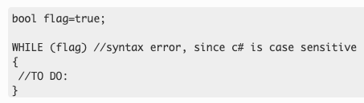
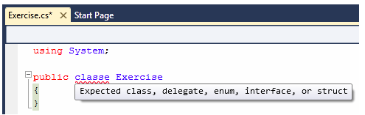
Les erreurs de syntaxe (suite…)
Quelques exemples:
Notes:
The consequences of these can prove to be extremely frustrating and expensive:
The general perception of the quality of the output begins to deteriorate as the team spends more and more time in fixing bugs than in actually creating new features
In extreme cases, adding features becomes virtually impossible with seemingly unrelated parts of the system failing due to the addition of a feature or, worse – fixing an earlier bug
Costs of adding features increases at an alarming rate with each delivery cycle
Adding more people becomes difficult, as they take a long time to come up to speed; sometimes, new team members are blatantly scared to touch large parts of the code, due to the fear of failure
Customer complaints increase, putting intense pressure to write an even worse code – to keep fixing the issues quickly

Slide 6
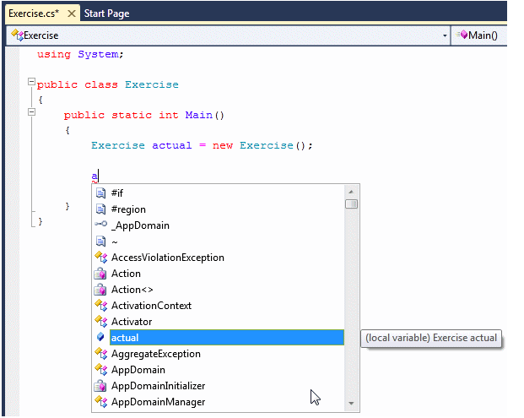
Les erreurs de syntaxe (suite…)
D’autres exemples:
Notes:
The consequences of these can prove to be extremely frustrating and expensive:
The general perception of the quality of the output begins to deteriorate as the team spends more and more time in fixing bugs than in actually creating new features
In extreme cases, adding features becomes virtually impossible with seemingly unrelated parts of the system failing due to the addition of a feature or, worse – fixing an earlier bug
Costs of adding features increases at an alarming rate with each delivery cycle
Adding more people becomes difficult, as they take a long time to come up to speed; sometimes, new team members are blatantly scared to touch large parts of the code, due to the fear of failure
Customer complaints increase, putting intense pressure to write an even worse code – to keep fixing the issues quickly

Slide 7
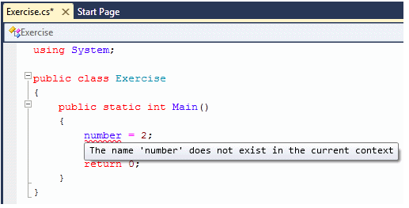
Les erreurs de syntaxe (suite…)
D’autres exemples:
Notes:
The consequences of these can prove to be extremely frustrating and expensive:
The general perception of the quality of the output begins to deteriorate as the team spends more and more time in fixing bugs than in actually creating new features
In extreme cases, adding features becomes virtually impossible with seemingly unrelated parts of the system failing due to the addition of a feature or, worse – fixing an earlier bug
Costs of adding features increases at an alarming rate with each delivery cycle
Adding more people becomes difficult, as they take a long time to come up to speed; sometimes, new team members are blatantly scared to touch large parts of the code, due to the fear of failure
Customer complaints increase, putting intense pressure to write an even worse code – to keep fixing the issues quickly

Slide 8
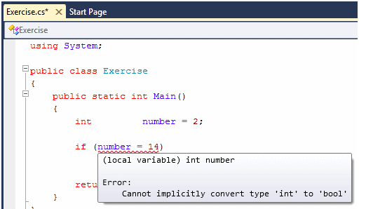
Les erreurs de syntaxe (suite…)
D’autres exemples:
Notes:
The consequences of these can prove to be extremely frustrating and expensive:
The general perception of the quality of the output begins to deteriorate as the team spends more and more time in fixing bugs than in actually creating new features
In extreme cases, adding features becomes virtually impossible with seemingly unrelated parts of the system failing due to the addition of a feature or, worse – fixing an earlier bug
Costs of adding features increases at an alarming rate with each delivery cycle
Adding more people becomes difficult, as they take a long time to come up to speed; sometimes, new team members are blatantly scared to touch large parts of the code, due to the fear of failure
Customer complaints increase, putting intense pressure to write an even worse code – to keep fixing the issues quickly

Slide 9
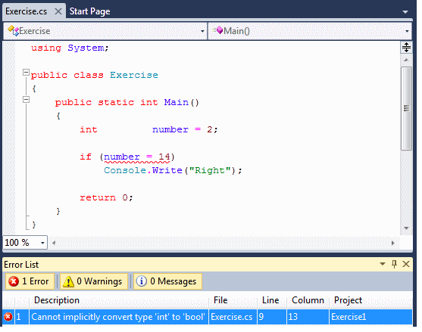
Les erreurs de syntaxe (suite…)
D’autres exemples:
Notes:
The consequences of these can prove to be extremely frustrating and expensive:
The general perception of the quality of the output begins to deteriorate as the team spends more and more time in fixing bugs than in actually creating new features
In extreme cases, adding features becomes virtually impossible with seemingly unrelated parts of the system failing due to the addition of a feature or, worse – fixing an earlier bug
Costs of adding features increases at an alarming rate with each delivery cycle
Adding more people becomes difficult, as they take a long time to come up to speed; sometimes, new team members are blatantly scared to touch large parts of the code, due to the fear of failure
Customer complaints increase, putting intense pressure to write an even worse code – to keep fixing the issues quickly

Slide 10

Les erreurs d’exécution
Comme le nom l’indique, les erreurs d’exécution sont des erreurs qui apparaissent pendant l’exécution, après que le code ait été compilé.
Pas d’erreurs de syntaxe
Le code ne s’exécute pas
Vous obtenez un message vous disant quel genre d’erreur il sagit, et une trace d’appel
Exemple: Programme pour ouvrir un fichier, mais fichier inexistant.
Pour résoudre ce genre d’erreur on peut réécrire le programme ou faire une gestion d’erreurs(avec des blocs try catch), ensuite recompiler le code et l’exécuter de nouveau.
Notes:
The consequences of these can prove to be extremely frustrating and expensive:
The general perception of the quality of the output begins to deteriorate as the team spends more and more time in fixing bugs than in actually creating new features
In extreme cases, adding features becomes virtually impossible with seemingly unrelated parts of the system failing due to the addition of a feature or, worse – fixing an earlier bug
Costs of adding features increases at an alarming rate with each delivery cycle
Adding more people becomes difficult, as they take a long time to come up to speed; sometimes, new team members are blatantly scared to touch large parts of the code, due to the fear of failure
Customer complaints increase, putting intense pressure to write an even worse code – to keep fixing the issues quickly

Slide 11

Les erreurs d’exécution
L’exemple ci-dessous est une erreur de type nullPointerException
Le compilateur dit où l’erreur a été découverte et c’est à nous de remonter à la source du problème et le résoudre.
Quelles informations pouvons nous tirer de ce message ?
Notes:
The consequences of these can prove to be extremely frustrating and expensive:
The general perception of the quality of the output begins to deteriorate as the team spends more and more time in fixing bugs than in actually creating new features
In extreme cases, adding features becomes virtually impossible with seemingly unrelated parts of the system failing due to the addition of a feature or, worse – fixing an earlier bug
Costs of adding features increases at an alarming rate with each delivery cycle
Adding more people becomes difficult, as they take a long time to come up to speed; sometimes, new team members are blatantly scared to touch large parts of the code, due to the fear of failure
Customer complaints increase, putting intense pressure to write an even worse code – to keep fixing the issues quickly

Slide 12
Gestion d’erreurs
La gestion d’erreurs est un mécanisme de détection et gestion d’erreurs.
On le fait avec l’utilisation de blocs Try-Catch-Finally pour essayer(try) d’exécuter des actions qui peuvent échouer, de gérer(catch) les exceptions quand elles se produisent et libérer les ressources après (finally)
Le bloc try-catch doit entouré le code qui peut produire l’erreur
En cas d’erreur, celle-ci sera attrapée pas le premier catch dans la pile d’appel
Les types d’exceptions sont dérivés de cette liste
Notes:
The consequences of these can prove to be extremely frustrating and expensive:
The general perception of the quality of the output begins to deteriorate as the team spends more and more time in fixing bugs than in actually creating new features
In extreme cases, adding features becomes virtually impossible with seemingly unrelated parts of the system failing due to the addition of a feature or, worse – fixing an earlier bug
Costs of adding features increases at an alarming rate with each delivery cycle
Adding more people becomes difficult, as they take a long time to come up to speed; sometimes, new team members are blatantly scared to touch large parts of the code, due to the fear of failure
Customer complaints increase, putting intense pressure to write an even worse code – to keep fixing the issues quickly

Slide 13
Gestion d’erreurs (suite)
Il est déconseillé d’attraper une erreur sans la gérer afin de laisser le programme dans un état stable
Le code dans le bloc finally est toujours exécuté même si l’exception à déjà été gérée ou throw dans le bloc catch
Utiliser le bloc finally pour relâcher les ressources (fichier ou stream ou buffer) qui étaient ouvertes.
Notes:
The consequences of these can prove to be extremely frustrating and expensive:
The general perception of the quality of the output begins to deteriorate as the team spends more and more time in fixing bugs than in actually creating new features
In extreme cases, adding features becomes virtually impossible with seemingly unrelated parts of the system failing due to the addition of a feature or, worse – fixing an earlier bug
Costs of adding features increases at an alarming rate with each delivery cycle
Adding more people becomes difficult, as they take a long time to come up to speed; sometimes, new team members are blatantly scared to touch large parts of the code, due to the fear of failure
Customer complaints increase, putting intense pressure to write an even worse code – to keep fixing the issues quickly

Slide 14
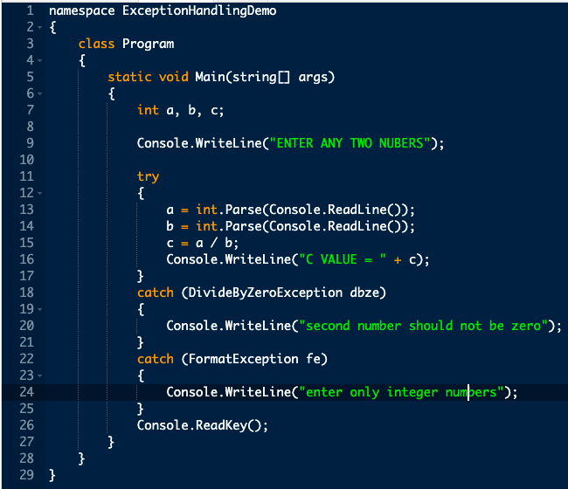
Le bloc try-catch (suite…)
Notes:
The consequences of these can prove to be extremely frustrating and expensive:
The general perception of the quality of the output begins to deteriorate as the team spends more and more time in fixing bugs than in actually creating new features
In extreme cases, adding features becomes virtually impossible with seemingly unrelated parts of the system failing due to the addition of a feature or, worse – fixing an earlier bug
Costs of adding features increases at an alarming rate with each delivery cycle
Adding more people becomes difficult, as they take a long time to come up to speed; sometimes, new team members are blatantly scared to touch large parts of the code, due to the fear of failure
Customer complaints increase, putting intense pressure to write an even worse code – to keep fixing the issues quickly

Slide 15
Les erreurs logiques
Une erreur logique se produit quand le code compile bien, exécute bien, mais le résultat n’est pas celui attendu.
Ce sont les plus difficiles à debugger
Utiliser des instructions d’affichage ou un debugger pour passer étapes par étapes à travers le program et voir ce qu’il fait.
Notes:
The consequences of these can prove to be extremely frustrating and expensive:
The general perception of the quality of the output begins to deteriorate as the team spends more and more time in fixing bugs than in actually creating new features
In extreme cases, adding features becomes virtually impossible with seemingly unrelated parts of the system failing due to the addition of a feature or, worse – fixing an earlier bug
Costs of adding features increases at an alarming rate with each delivery cycle
Adding more people becomes difficult, as they take a long time to come up to speed; sometimes, new team members are blatantly scared to touch large parts of the code, due to the fear of failure
Customer complaints increase, putting intense pressure to write an even worse code – to keep fixing the issues quickly

Slide 16
Quelques avertissements fréquents
Unreachable code detected - CS0162
The variable '{0}' is declared but never used – CS0168
The variable '{0}' is assigned but its value is never used – CS0219
Assignment in conditional expression is always constant; did you mean to use == instead of = ? - CS0665
Assignment/Comparison made to same variable; did you mean to assign something else? - CS1717/CS1718
Les codes ci-dessus peuvent être utilisé pour voir sur le site de Microsoft la documentation officielle de l’avertissement ainsi que des exemples.
Notes:
The consequences of these can prove to be extremely frustrating and expensive:
The general perception of the quality of the output begins to deteriorate as the team spends more and more time in fixing bugs than in actually creating new features
In extreme cases, adding features becomes virtually impossible with seemingly unrelated parts of the system failing due to the addition of a feature or, worse – fixing an earlier bug
Costs of adding features increases at an alarming rate with each delivery cycle
Adding more people becomes difficult, as they take a long time to come up to speed; sometimes, new team members are blatantly scared to touch large parts of the code, due to the fear of failure
Customer complaints increase, putting intense pressure to write an even worse code – to keep fixing the issues quickly

Slide 17
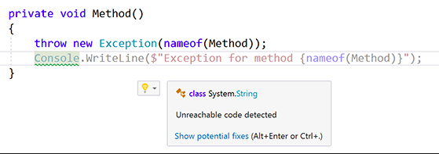
Quelques avertissements fréquents (suite…)
Notes:
The consequences of these can prove to be extremely frustrating and expensive:
The general perception of the quality of the output begins to deteriorate as the team spends more and more time in fixing bugs than in actually creating new features
In extreme cases, adding features becomes virtually impossible with seemingly unrelated parts of the system failing due to the addition of a feature or, worse – fixing an earlier bug
Costs of adding features increases at an alarming rate with each delivery cycle
Adding more people becomes difficult, as they take a long time to come up to speed; sometimes, new team members are blatantly scared to touch large parts of the code, due to the fear of failure
Customer complaints increase, putting intense pressure to write an even worse code – to keep fixing the issues quickly

Slide 18
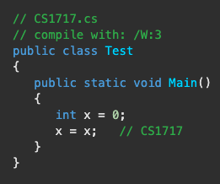
Quelques avertissements fréquents (suite…)
Notes:
The consequences of these can prove to be extremely frustrating and expensive:
The general perception of the quality of the output begins to deteriorate as the team spends more and more time in fixing bugs than in actually creating new features
In extreme cases, adding features becomes virtually impossible with seemingly unrelated parts of the system failing due to the addition of a feature or, worse – fixing an earlier bug
Costs of adding features increases at an alarming rate with each delivery cycle
Adding more people becomes difficult, as they take a long time to come up to speed; sometimes, new team members are blatantly scared to touch large parts of the code, due to the fear of failure
Customer complaints increase, putting intense pressure to write an even worse code – to keep fixing the issues quickly

Slide 19
Evaluation Formative
A la maison, essayer de reproduire les exemples d’erreurs de syntaxe discuté dans cette présentation.
Tapez les codes donnés à la diapositive 16 sur google.ca pour voir la documentation des avertissements, et essayez de les reproduire avec Visual studio.
Notes:
The consequences of these can prove to be extremely frustrating and expensive:
The general perception of the quality of the output begins to deteriorate as the team spends more and more time in fixing bugs than in actually creating new features
In extreme cases, adding features becomes virtually impossible with seemingly unrelated parts of the system failing due to the addition of a feature or, worse – fixing an earlier bug
Costs of adding features increases at an alarming rate with each delivery cycle
Adding more people becomes difficult, as they take a long time to come up to speed; sometimes, new team members are blatantly scared to touch large parts of the code, due to the fear of failure
Customer complaints increase, putting intense pressure to write an even worse code – to keep fixing the issues quickly

